Slide 1
Network Intrusion detection
By :
Shahad alomayrah

Slide 2
introduction
The issue Network intrusion detection is an important and sensitive issue when it comes to the privacy of organizations and individuals, especially when transmitting important and sensitive information.

Slide 3
Methodology
Step 3
Step 1
Step 2
Choose dataset
Build classification Model
Step 4
EDA
Predication

Slide 4
DATA DESCRIPTION
01
04
02
05
03
06
check for
duplicates
Numbers of Rows $ Columns?
25192 Rows 42 Columns
Dummy Variables $
Label
Collected the data from Kaggle website
check Null
Value
Balanced Dataset

Slide 5
Experiment
Model | Training | testing | accuracy | f1_score | Recall | precision
Logistic Regression | 0.87 | 0.88 | 0.88 | 0.88 | 0.89 | 0.88
KNN | 0.99 | 0.98 | 0.98 | 0.98 | 0.99 | 0.99
DecisionTreeClassifier | 0.96 | 0.96 | 0.96 | 0.96 | 0.97 | 0.96
Random forest | 1 | 0.99 | 0.96 | 0.96 | 0.99 | 0.99
XG-Boost | 1 | 0.99 | 0.99 | 0.99 | 0.99 | 0.99

Slide 6
Experiment
Model | Training | Testing | accuracy | f1_score | Precision | Recall
Grid Search RandomForestClassifier | 0.99 | 0.99 | 0.99 | 0.99 | 0.99 | 0.99
Grid Search KNN | 0.98 | 0.98 | 0.98 | 0.98 | 0.98 | 0.98
Grid Search Logistic Regression | 0.87 | 0.88 | 0.88 | 0.88 | 0.88 | 0.88

Slide 7
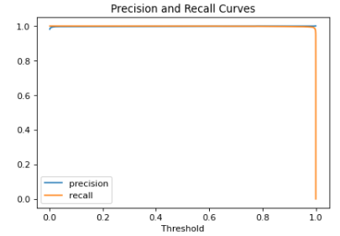
Precision and Recall Curves

Slide 8
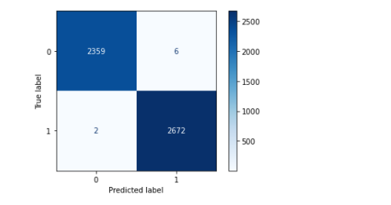
Confusion Matrix

Slide 9
THANKS!
Do you have any questions?

